Slide 1
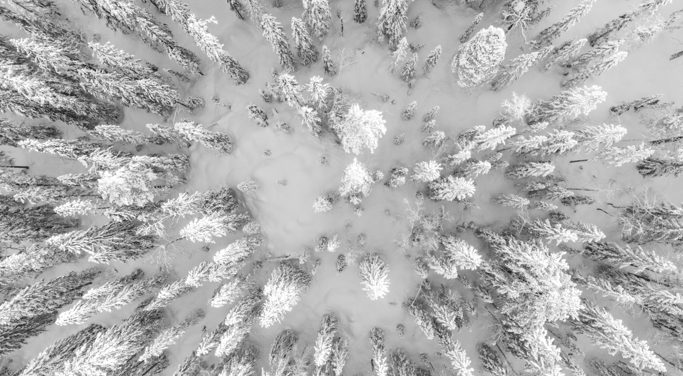
Big Mountain Ski Resort: predictive modeling ticket price from resort features
Virginia Jaquish, Springboard Data Science Student

Slide 2
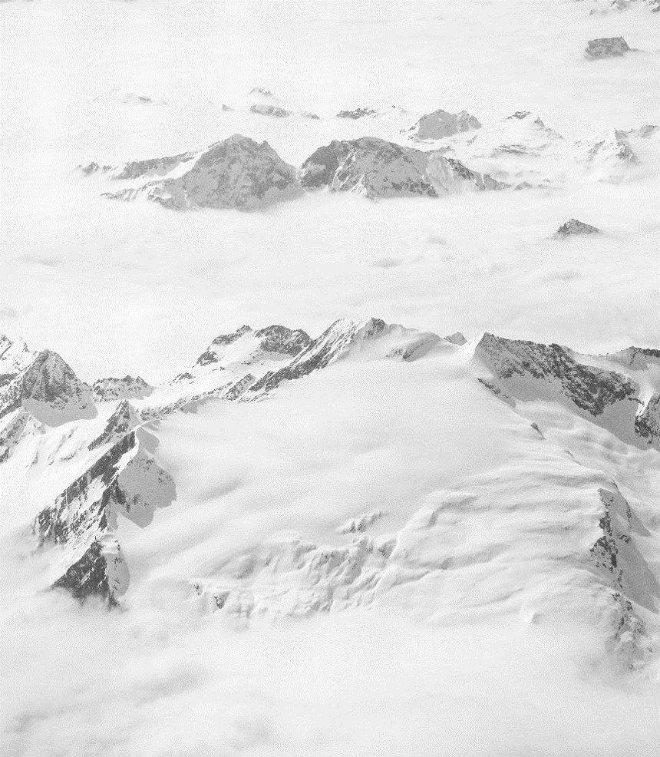
Problem Statement
Big Mountain Resort
Unique location with views of Glacier National Park and Flathead National Forest
350,000 yearly visitors
Currently set ticket price using the average price of resorts in market segment
Interested in making facility improvements or cuts to increase profit margin

Slide 3
Criteria for Success
Big Mountain Resort
Use a dataset of 300 other ski resorts to evaluate ticket price trends
Determine which resort features correlate to higher ticket prices
Create a model to predict ticket price based on resort features
Determine which improvements or cuts might help to increase Big Mountain’s profit margin

Slide 4
Recommendations and Key Findings
Random Forest Regression Model
Big Mountain currently charges $81.00 adult weekend ticket price
Model predicts that Big Mountains current ticket price should be $95.87
Improvement scenario add a run, increasing the vertical drop by 150 feet, and installing additional chair lift
Increase ticket price by $8.61
Season profit increase of $15,065,471
Ticket price reduction is the same for cutting 3-5 runs -$0.75

Slide 5
The Model
Random Forest Regression Model
We divided the data 70/30 for training and test datasets
We created two models using the training dataset
Linear regression
Random Forest regression
Mean absolute error of ticket price predictions
Linear Regression $11.79
Random Forest $9.65
Mean as predictor $19.13
Predictions using the Random Forest model have lower error than the other models

Slide 6
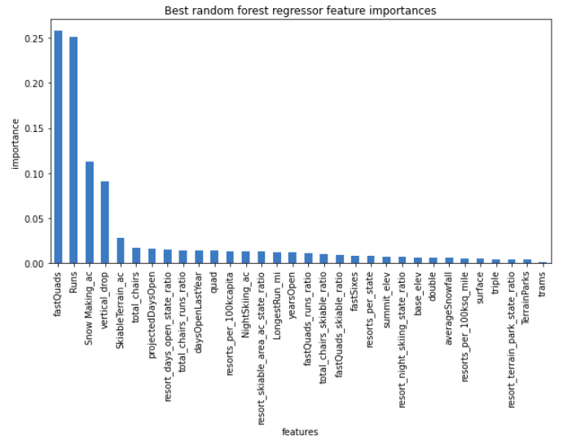
Key Ski Resort Features
Which ski resort features are important for setting ticket price?
Features used by the model to predict ticket price
fast quads
number of runs
snow making acres
vertical drop
skiable area

Slide 7
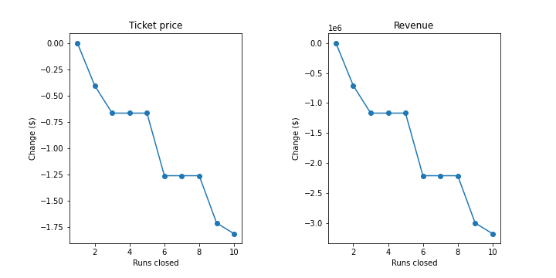
Closing Runs
How would closing ski runs impact the Big Mountain’s ticket price?
Predicted ticket price change
Closing 1 run no change
Closing 2 runs a < -$0.50
Closing 3-5 runs plateaus < -$0.75
Closing 6-8 runs plateaus < -$1.25

Slide 8
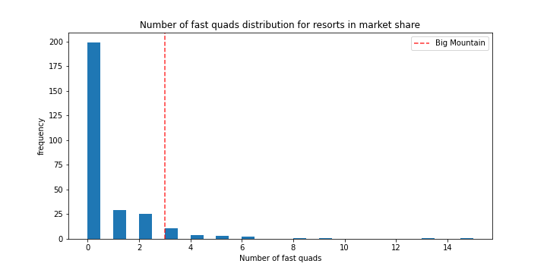
Big Mountain’s Standing
How do the features of Big Mountain compare to other resorts? Can we really justify charging more?
Number of fast quads
Big Mountain = 3

Slide 9
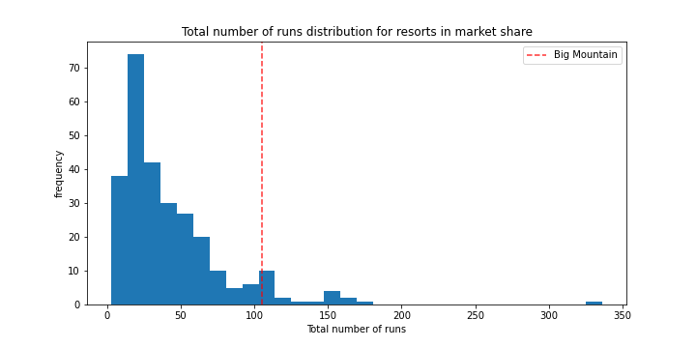
Big Mountain’s Standing
How do the features of Big Mountain compare to other resorts? Can we really justify charging more?
Runs
Big Mountain = 105

Slide 10
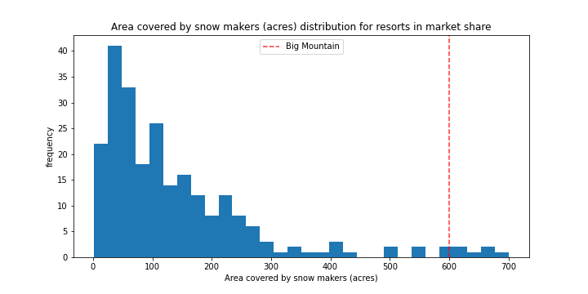
Big Mountain’s Standing
How do the features of Big Mountain compare to other resorts? Can we really justify charging more?
Area Covered by Snow Makers
Big Mountain = 600 acres

Slide 11
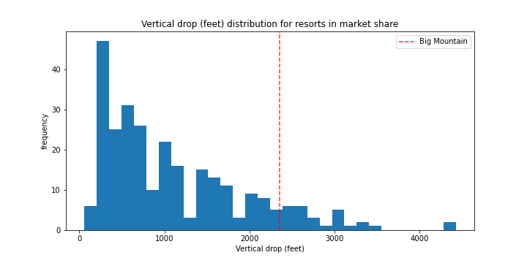
Big Mountain’s Standing
How do the features of Big Mountain compare to other resorts? Can we really justify charging more?
Vertical Drop
Big Mountain = 2,353 ft

Slide 12
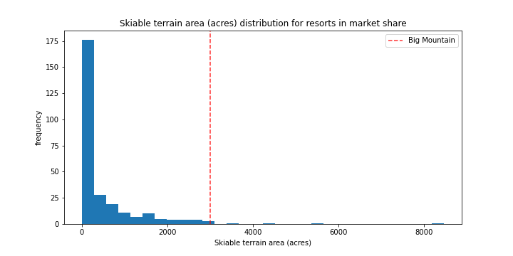
Big Mountain’s Standing
How do the features of Big Mountain compare to other resorts? Can we really justify charging more?
Skiable terrain
Big Mountain = 3,000 acres

Slide 13
Conclusions
Using the average ticket price sets a lower ticket price
There are resort features that are linked to ticket price and these features should be the focus of future improvement
Big Mountain should be charging around $95.87
Increasing ticket prices is justified because Big Mountain has high values for many of the key features

Slide 14

Large Image Slide
Thank you.

